Slide 1
LENDING CLUB CASE STUDY SUBMISSION
Group Facilitator: Anunay Aatipamula
Team Member: Roshan Bhore

Slide 2
Project Outline
About the company
Lending Club – A loan provider company. Loan data for all loans issued through the time period 2007 to 2011 is provided
Context
Lending Club wants to understand the driving factors behind loan default, i.e. the driver variables which are strong indicators of default. The company can utilize this knowledge for its portfolio and risk assessment.
Business Objective
The objective is to identify these risky loan applicants to reduce the amount of credit loss by identifying the driving factors.

Slide 3
Approach
Recommendations
Bivariate Analysis
Univariate Analysis
Data Cleaning
Analyzing data distribution for target value across various attributes
Create derived variables such as range buckets for largely distributed numerical data such as int_rate, annual_inc
Recommendations to identify these risky loan applicants to reduce the amount of credit
Key attributes which will help determine this objective
Dropping columns with null values and rows with missing data
Data conversion for fields object to date, object to int and converting percentages to float
Check correlation among attributes
Understanding how two variables effect the target variable

Slide 4
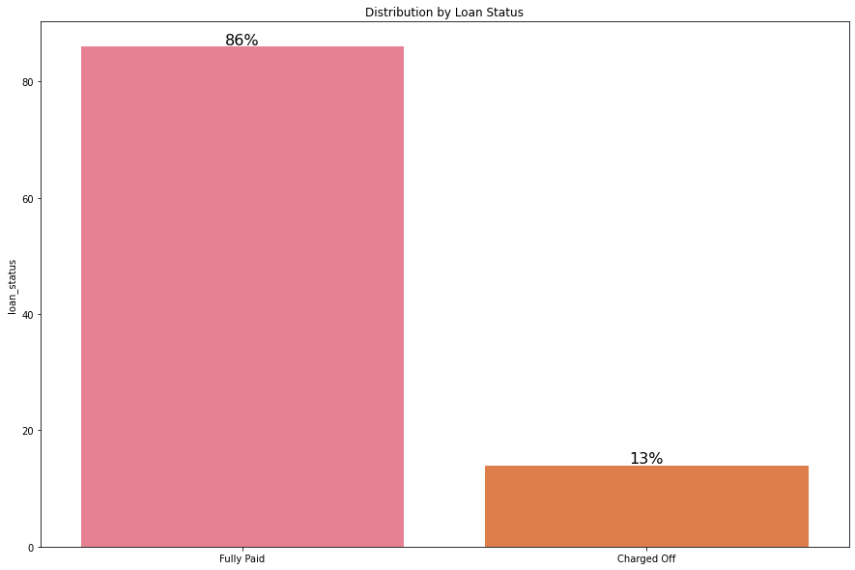
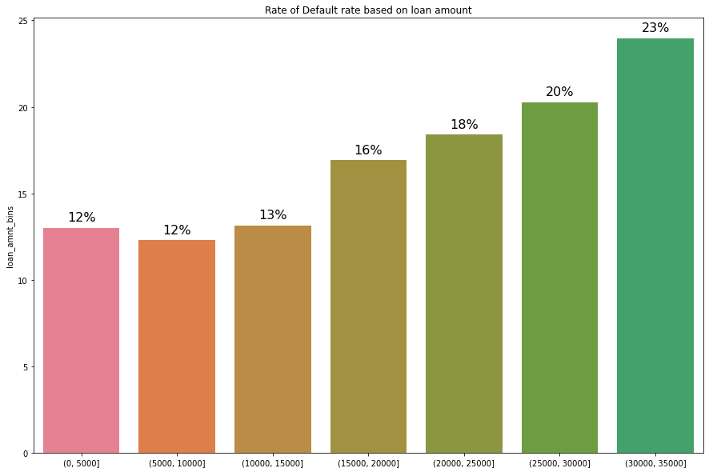
Univariate Analysis
Loan Distribution
Majority of the loans are charged off 86%
Only 13% of loans are charged
Distribution of loan amounts in charged off loans show 23% percent of larger loans get defaulted
Loan Amount
With increase in loan amount as the risk associated increase therefore rate of default also increases
Loan amount combined with interest rate, grade and term are some of the key factors which influence charged off loans

Slide 5
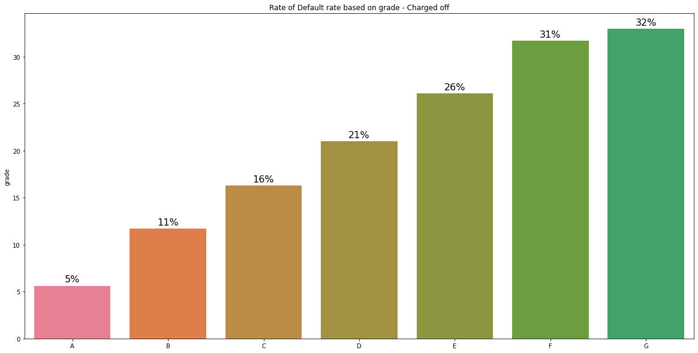
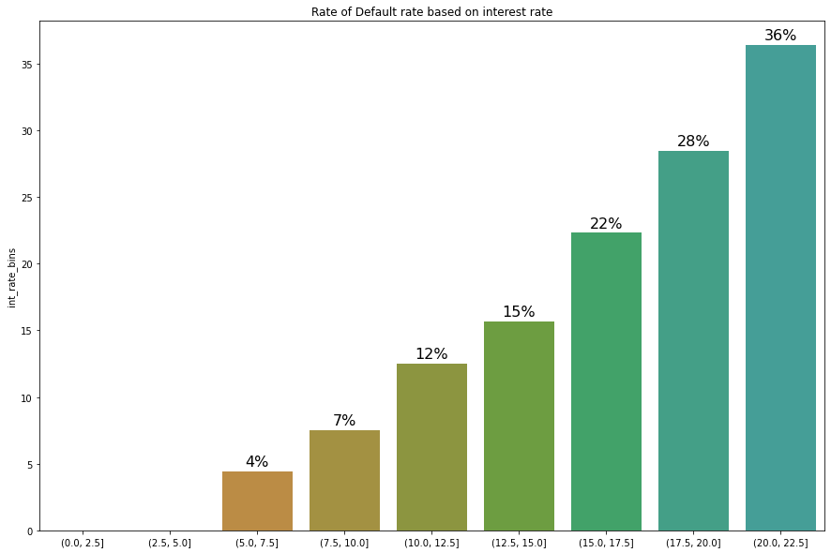
Analysis – Interest rate and Grade
Interest rates are also one of the key factor to determine charged off loans.
From below observation it is clear that with increasing interest rate the rate of default also increase
Possible reasons for high interest rate suggest larger loan amount, loan period, grade of loan
Most higher grade loans are fully paid
Rate of default also tend to increase with declining grades
Factors for lower grades
Larger loan amount
Loan repayment risk
High interest rate
Annual Income

Slide 6
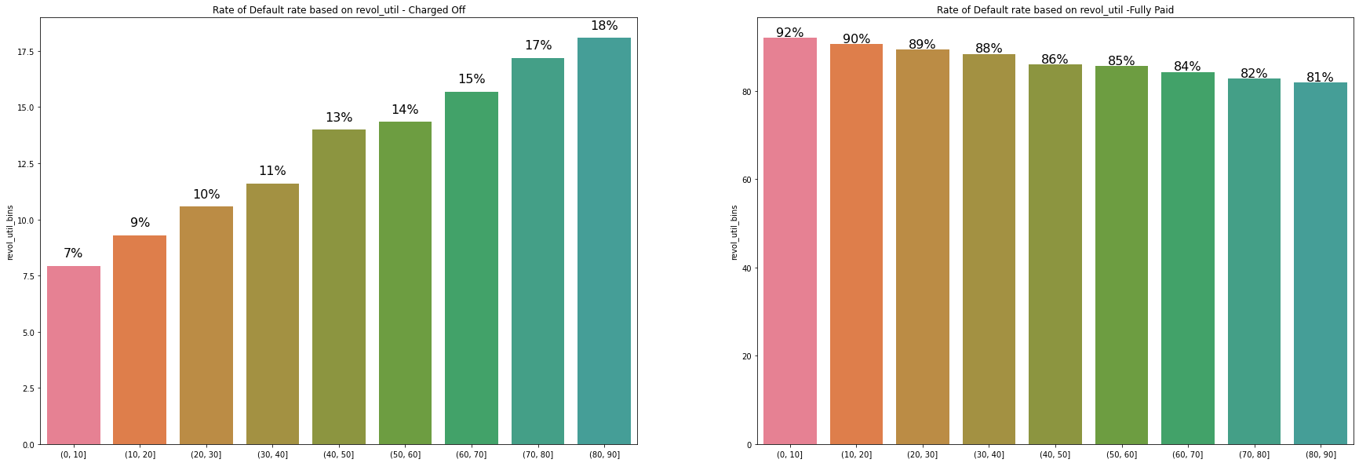
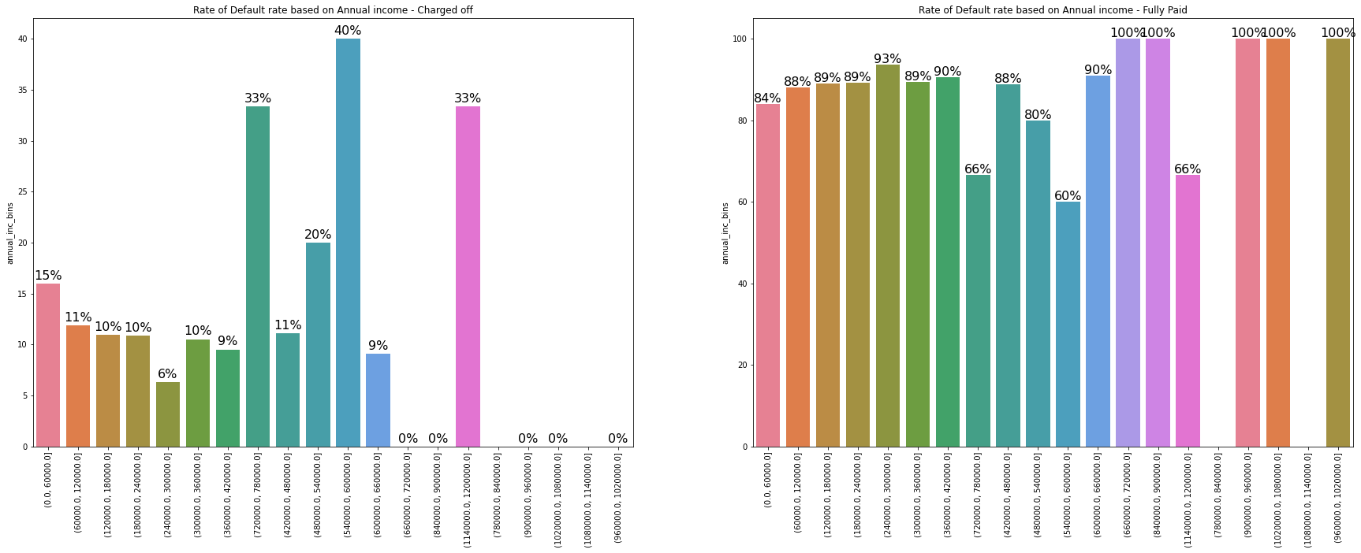
Analysis – Annual Income and Utilization Rate
People with higher income generally tend to fully pay the loan amounts
People with lesser income are more tend to default
Unique outlier in visualization suggests that people with income in the rage 540k-600k tend to default significantly higher(40%) than other income ranges
Rate of default increase with increase in the amount of credit the borrower is using relative to all available revolving credit
Which can also be observed in fully paid loans the rate of fully paid loans keep decreasing with increase revolving credit

Slide 7
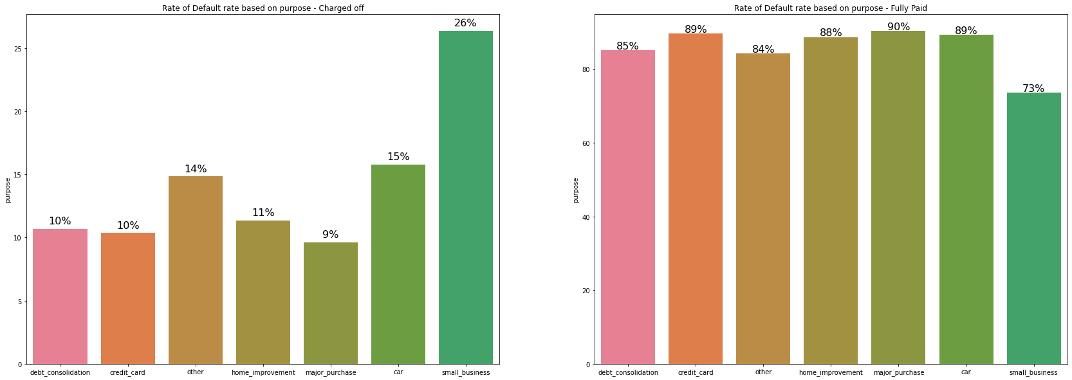
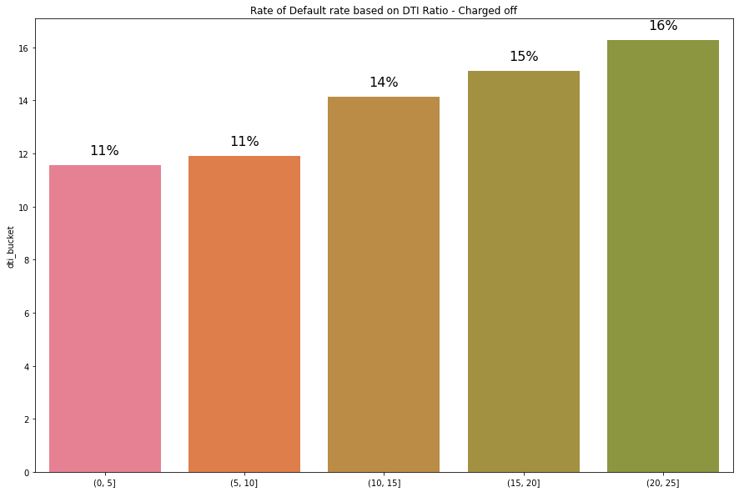
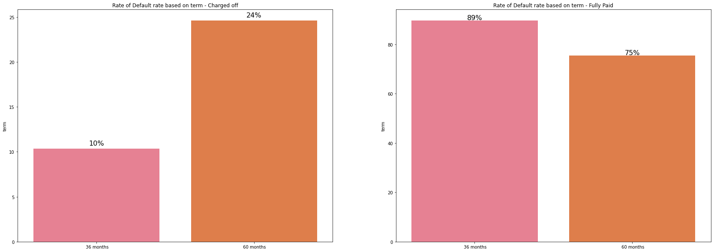
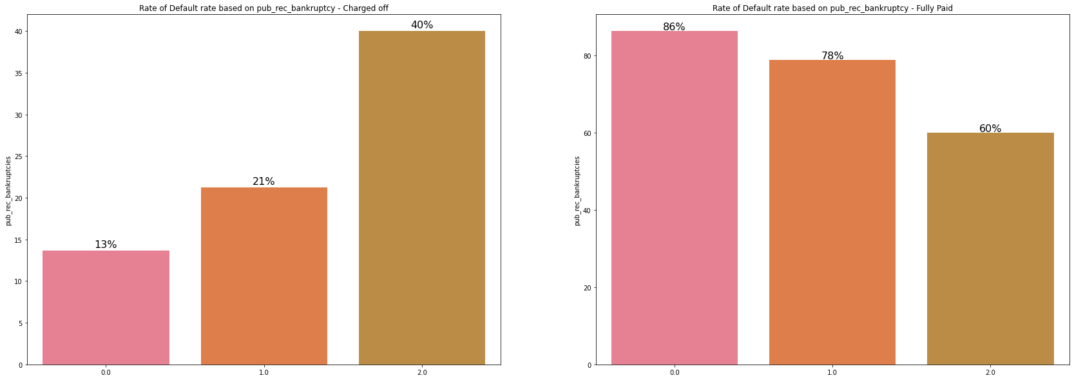
Analysis – Bankruptcies, Purpose and Term
High DTI ratio can signal that an individual has too much debt for the amount of income earned each month which explain the reason to default. Higher the DTI higher the chances of loan being Charged Off
Rate of Default for small business (26%) is higher when compared to other purposes
Rate of default increase when the Number of public record bankruptcies increases
Rate of Default is higher for loans with 60 months term
Which suggests higher loan amount are associated with greater risk and other key factors like DTI ratio, interest rate

Slide 8
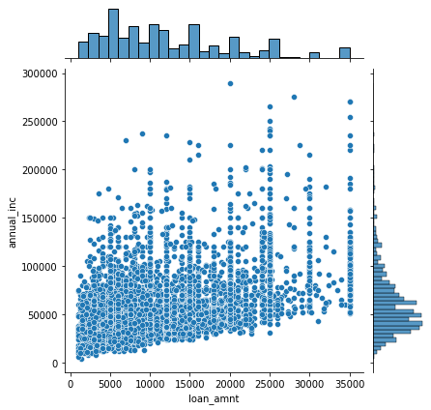
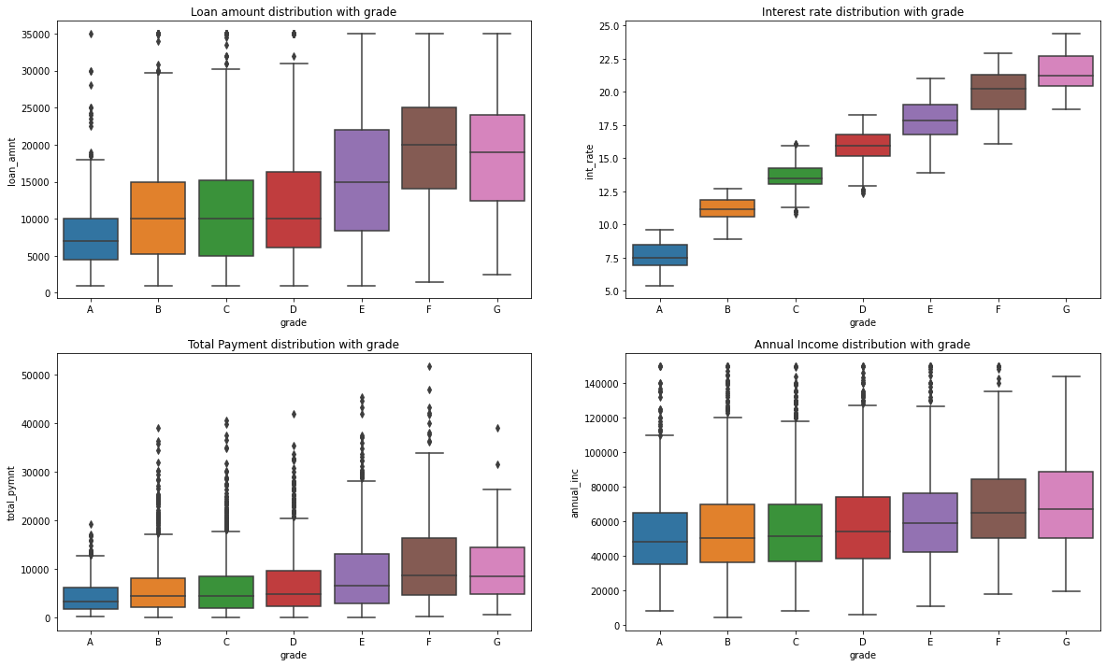
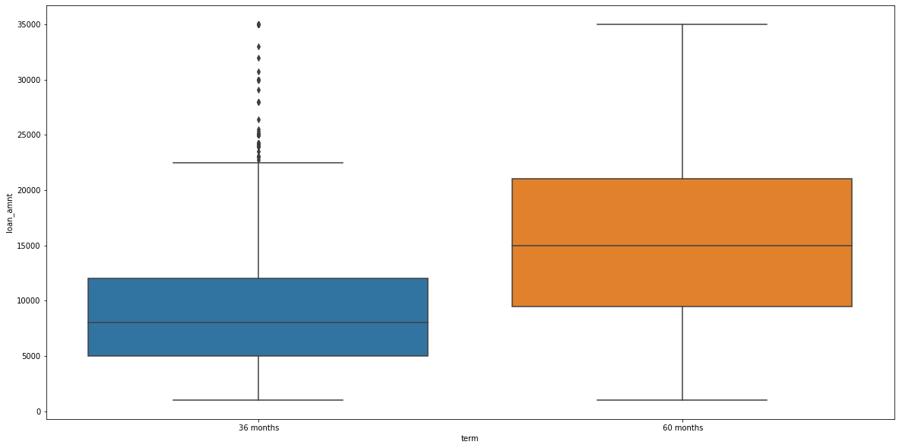
Bi-Variate Analysis
Bivariate analysis of grade on various attributes such as interest rate, loan amount, annual income and total payment
With declining grades rate of interest increases due to type of loan, risk associated with higher loan amounts
Consumers with income lower than 50000 taking loans of 25000 or higher would be risky loans.
As there is too much debt for the amount of income earned each month which explain the reason to default
It is evident that 60 months term with larger loan amount are associated with higher interest rate which increases the rate of default
Rate of default is higher when the term is 60 months due to higher loan amount which indicates risk associated with it

Slide 9
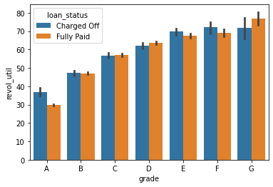
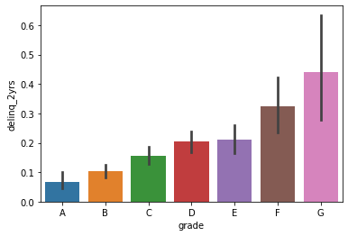
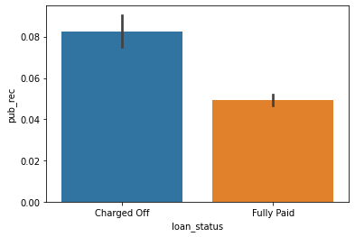
Bi-Variate Analysis
Revolving utilization rate and grade(and therefore interest rate) are correlated in some way.
The Revolving utilization rate is positively correlated to the grade.
As the grade goes from A to E the Revolving utilization rate also increases.
This may be because higher loan amounts are associated with higher grades.
Lower grades are associated with higher number of delinquencies(>3) which effects rate of default.
Low number of delinquencies are more found towards higher grade which infers less chance of loan being defaulted
Mean of public record bankruptcies for charged off loans is greater than fully paid loans which suggests rate of default increase when derogatory records increases

Slide 10
Summary
Key driving factors
Grade
Interest rate
Loan Amount
DTI ratio
Revolving Utilization rate
Purpose
Loan period
Open Credit lines
Annual Income
Recommendations
Stop approving loans for high DTI ratio which suggests that individual has too much debt for the amount of income earned each month which explain the reason to default
Stop approving loans for consumers with prior bankruptcies, bad record for larger loans
Decrease loan approvals for purpose - small business
Decrease loan approvals with number of open credit lines in the borrower's credit file is over 25
Decrease loan approvals with DTI ratio greater than 15%
Decrease loan approvals with revolving utilization rate greater than 75%
Stop approving lower grade loans with higher dti ratio

